Slide 1
Deep Image Prior
Presented by-
Manoj Gembali (A20527288)
Tushar Gwal (A20449419)

Slide 2
Problem Statement and Background
Image Restoration Challenges :
Denoising: Remove unwanted noise (random variations, sensor noise) while preserving image details
Inpainting:
Text removal: Eliminate overlaid text
Hole filling: Fill missing or damaged regions
Large-Scale Reconstruction: Handle cases with significant image corruption like large missing regions or severe degradation
Restoring image using Traditional Approach:
Prior in Image Restoration: In image processing, priors encode our assumptions about what makes an image look "natural." When restoring degraded images (noisy, blurry, or incomplete), priors help:
Distinguish between valid image content and noise/artifacts
Guide reconstruction when information is missing
Ensure the restored image looks realistic
CNN are trained on complex image priors from large datasets which provides them:
End to End learning where CNNs can learn to map corrupted images directly to clean images.
Hierarchical feature learning which allows Deep networks to capture both low-level and high-level image features.

Slide 3
Problem Statement and Background
Limitations of conventional approaches:
Reliance on large datasets
Poor generalization to unseen degradation types
Deep Image Prior (DIP) as a novel solution:
Uses CNN architecture as an implicit prior
No need for external training data

Slide 4
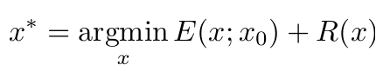
Proposed Solution - Deep Image Prior
In traditional approach, When dealing with degraded images , we need two key components:
Data Term: Measures how well our solution matches the degraded input
Prior Term: Guides the reconstruction toward natural-looking images
Traditional reconstruction can be formulated as:
where:
E(x; x0) is the data term
R(x) is the prior/regularizer
x0 is the degraded image
x* is the restored image

Slide 5
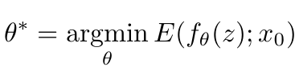
Proposed Solution - Deep Image Prior
Whereas in Deep Image Prior (DIP), as opposed to traditional image restoration tasks with explicit priors, the approach leverages the structure of a convolutional neural network itself as an implicit prior for natural images. Instead of using pre-trained networks or explicitly defined regularization terms, DIP employs an untrained CNN that maps fixed random noise to an output image. The network weights become the optimized parameters, effectively reparametrizing the image as
x = fθ(z) , where fθ is the untrained CNN, z is fixed random noise, and θ are the network parameters.
The optimization objective is to find the optimal network parameters θ* that minimize the error between the network output and the corrupted image, without any explicit prior term.
where:
fθ is an untrained CNN z is fixed random noise
θ are network parameters
No explicit prior term R(x) Prior is implicit in CNN architecture

Slide 6
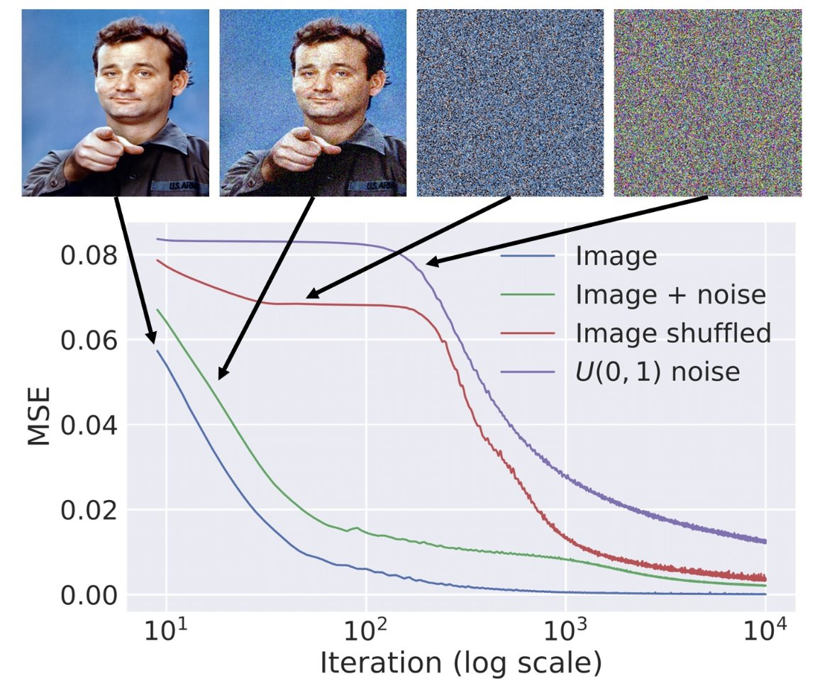
Why it works?
Key Insight from CNN Behavior:
Critical Observation: CNNs can fit random labels in classification
Shows networks have massive capacity to overfit
Yet they still exhibit strong inductive bias towards structured data
Important implication: Architecture itself imposes meaningful structure
Network's "Natural Impedance":
Fast convergence for natural image structures
Slow convergence for noise/artifacts
Network architecture naturally resists noise while preserving image content
Early stopping exploits difference in fitting speeds
Multi-scale Structure Properties:
Generates and organizes features hierarchically from random noise
Gradually transforms noise into meaningful image content
Skip connections preserve and refine details across scales
Network structure develops and exploits self-similarities during optimization
Implicit Regularization:
Network structure biases towards smooth, structured solutions
Convolutional layers promote natural image statistics

Slide 7
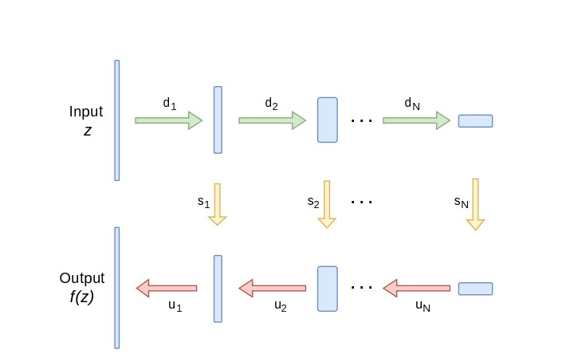
Deep Image Prior Architecture
DIP is U-Net-Inspired Encoder-Decoder Structure
Encoder:
Processes and gradually transforms random noise into structured representations
Depth affects the complexity of patterns that can emerge
Decoder:
Transforms encoded representations into image-like output
Combines high-level features with spatial information from the encoder.

Slide 8
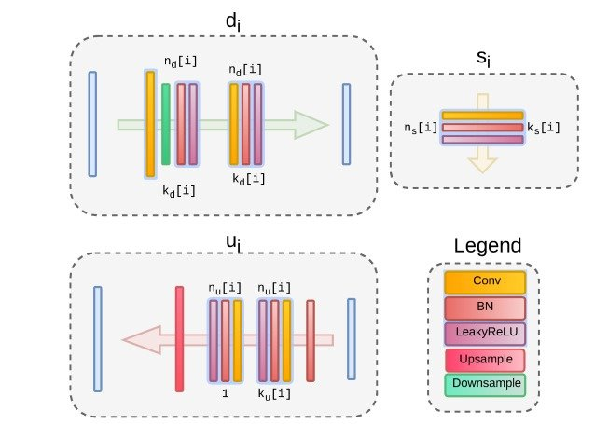
Deep Image Prior Architecture
Skip Connections:
Links corresponding layers in the encoder and decoder.
Helps retain important details that might be lost during encoding.
Reflection Padding:
Pads the image by reflecting its borders.
Minimizes edge artifacts and ensures smoother image edges.

Slide 9
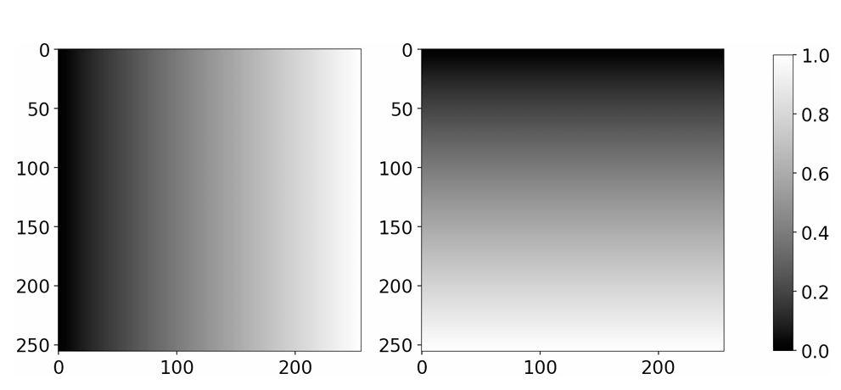
Implementation Details
Input Types:
Random Noise (Denoising, Inpainting, Reconstruction):
Utilized as the initial input to the network.
Meshgrid (Hole Filling):
Encodes spatial information explicitly.
Advantageous for reconstructing missing regions with spatial coherence.
Skip Connections:
Implemented in Denoising, Inpainting, Reconstruction:
Purpose: Preserve spatial details by transferring high-resolution features from encoder to decoder.
None in Hole Filling:
Reason: Focus on reconstructing large missing regions where skip connections may introduce artifacts or impede the generation of coherent structures.
Upsampling Methods:
Bilinear Upsampling (Denoising & Reconstruction):
Provides smooth and continuous upsampling.
Enhances the quality of reconstructed images by maintaining gradient continuity.
Nearest Neighbor Upsampling (Inpainting & Hole Filling):
Preserves hard edges and sharp transitions, which are beneficial for filling discrete or well-defined missing regions.

Slide 10
Training Process
Adam Optimizer
Adaptive learning rates
Efficient gradient handling
Loss Function
Mean Squared Error (MSE) for All Tasks
Masked MSE for Inpainting, Hole Filling, Reconstruction
Calculated only over known regions
Focuses learning, preserves unaltered areas
Noise-Based Regularization
Adds Gaussian noise to input during training
Improves generalization and exploration
Prevents overfitting to corrupted input
Checkpoint Mechanism
Tracks Peak Signal-to-Noise Ratio (PSNR)
Saves best-performing models
Prevents loss due to overfitting or fluctuations

Slide 11
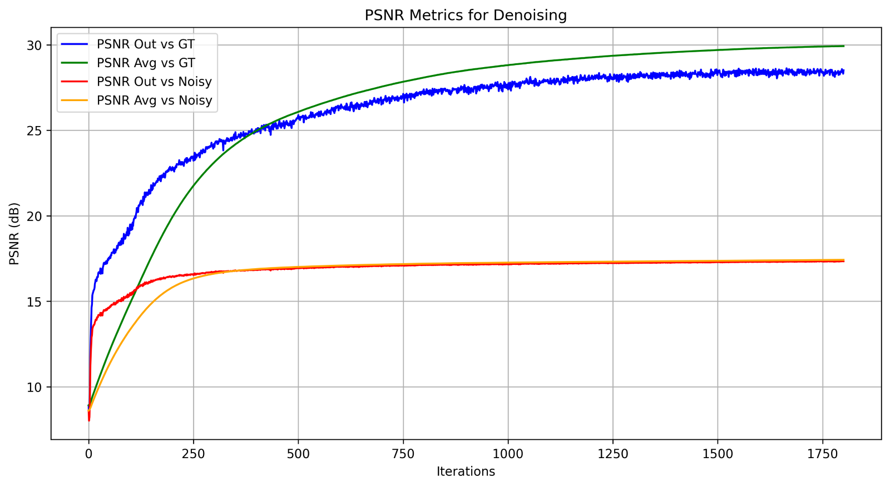
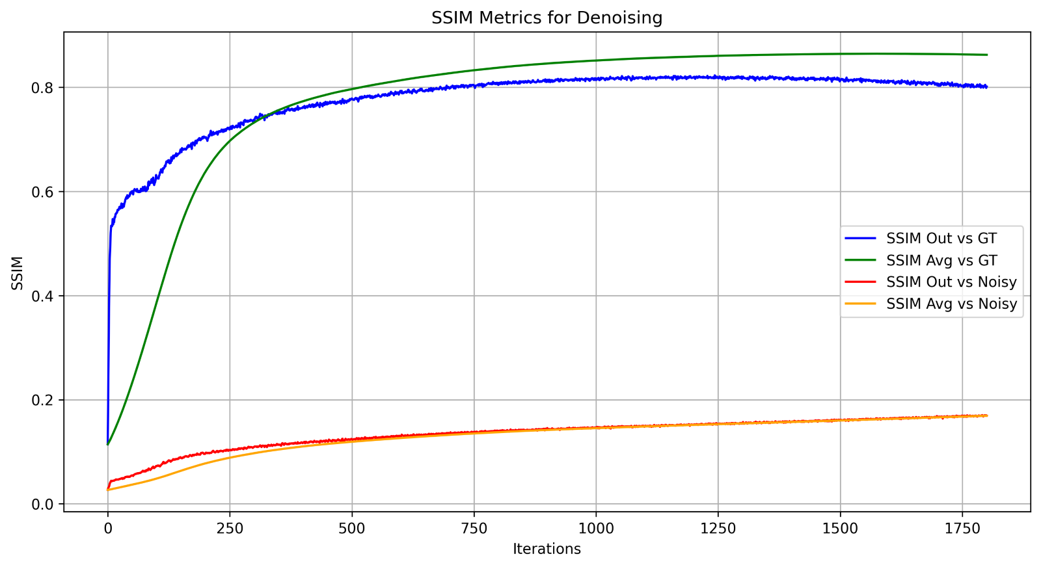
Quantitative Results - Denoising
Metrics
PSNR (Peak Signal-to-Noise Ratio): Measures image quality based on pixel-level differences. Higher values (typically above 30 dB) indicate better quality.
SSIM (Structural Similarity Index Measure): Assesses image quality based on structural similarities. Values closer to 1 indicate better quality, with >0.95 considered excellent.
 | PSNR | SSIM
Final_vs_GT | 26.633632738881374 | 0.8262966
Avg_vs_GT | 29.922273164622798 | 0.8624169
Final_vs_Noisy | 17.159526820560004 | 0.175373
Avg_vs_Noisy | 17.42376855052601 | 0.16904747

Slide 12
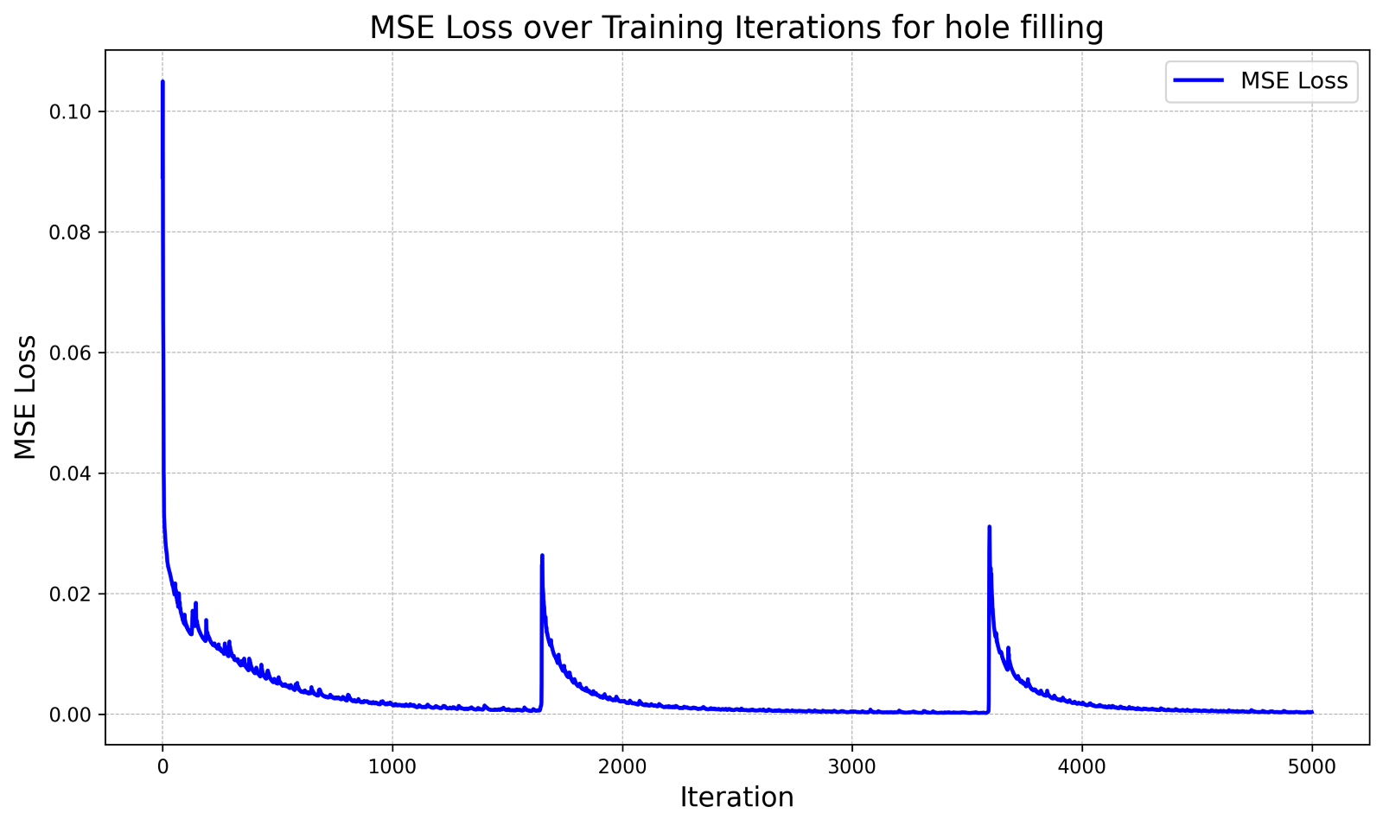
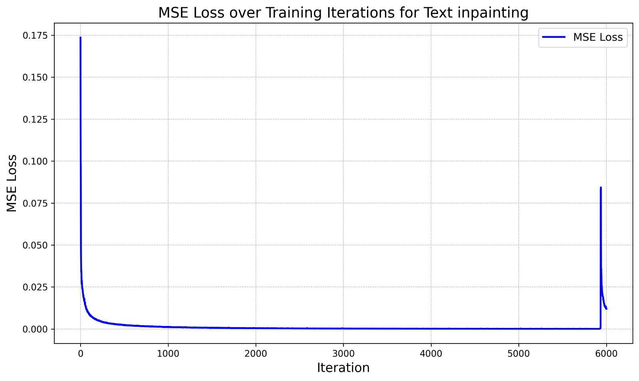
Quantitative Results – Inpainting
The SSIM metric is used to evaluate how closely the filled-in regions resemble the ground truth. ​
High SSIM scores indicated successful reconstruction in masked regions.
Text Inpainting
Hole filling
SSIM score: [0.96201557]
SSIM score: [0.9466905]

Slide 13
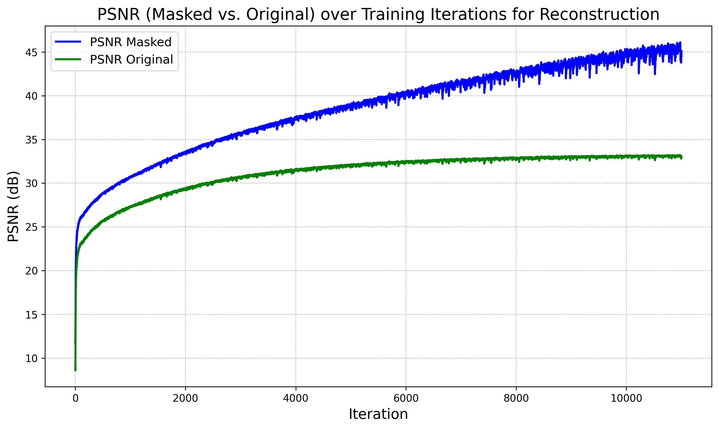
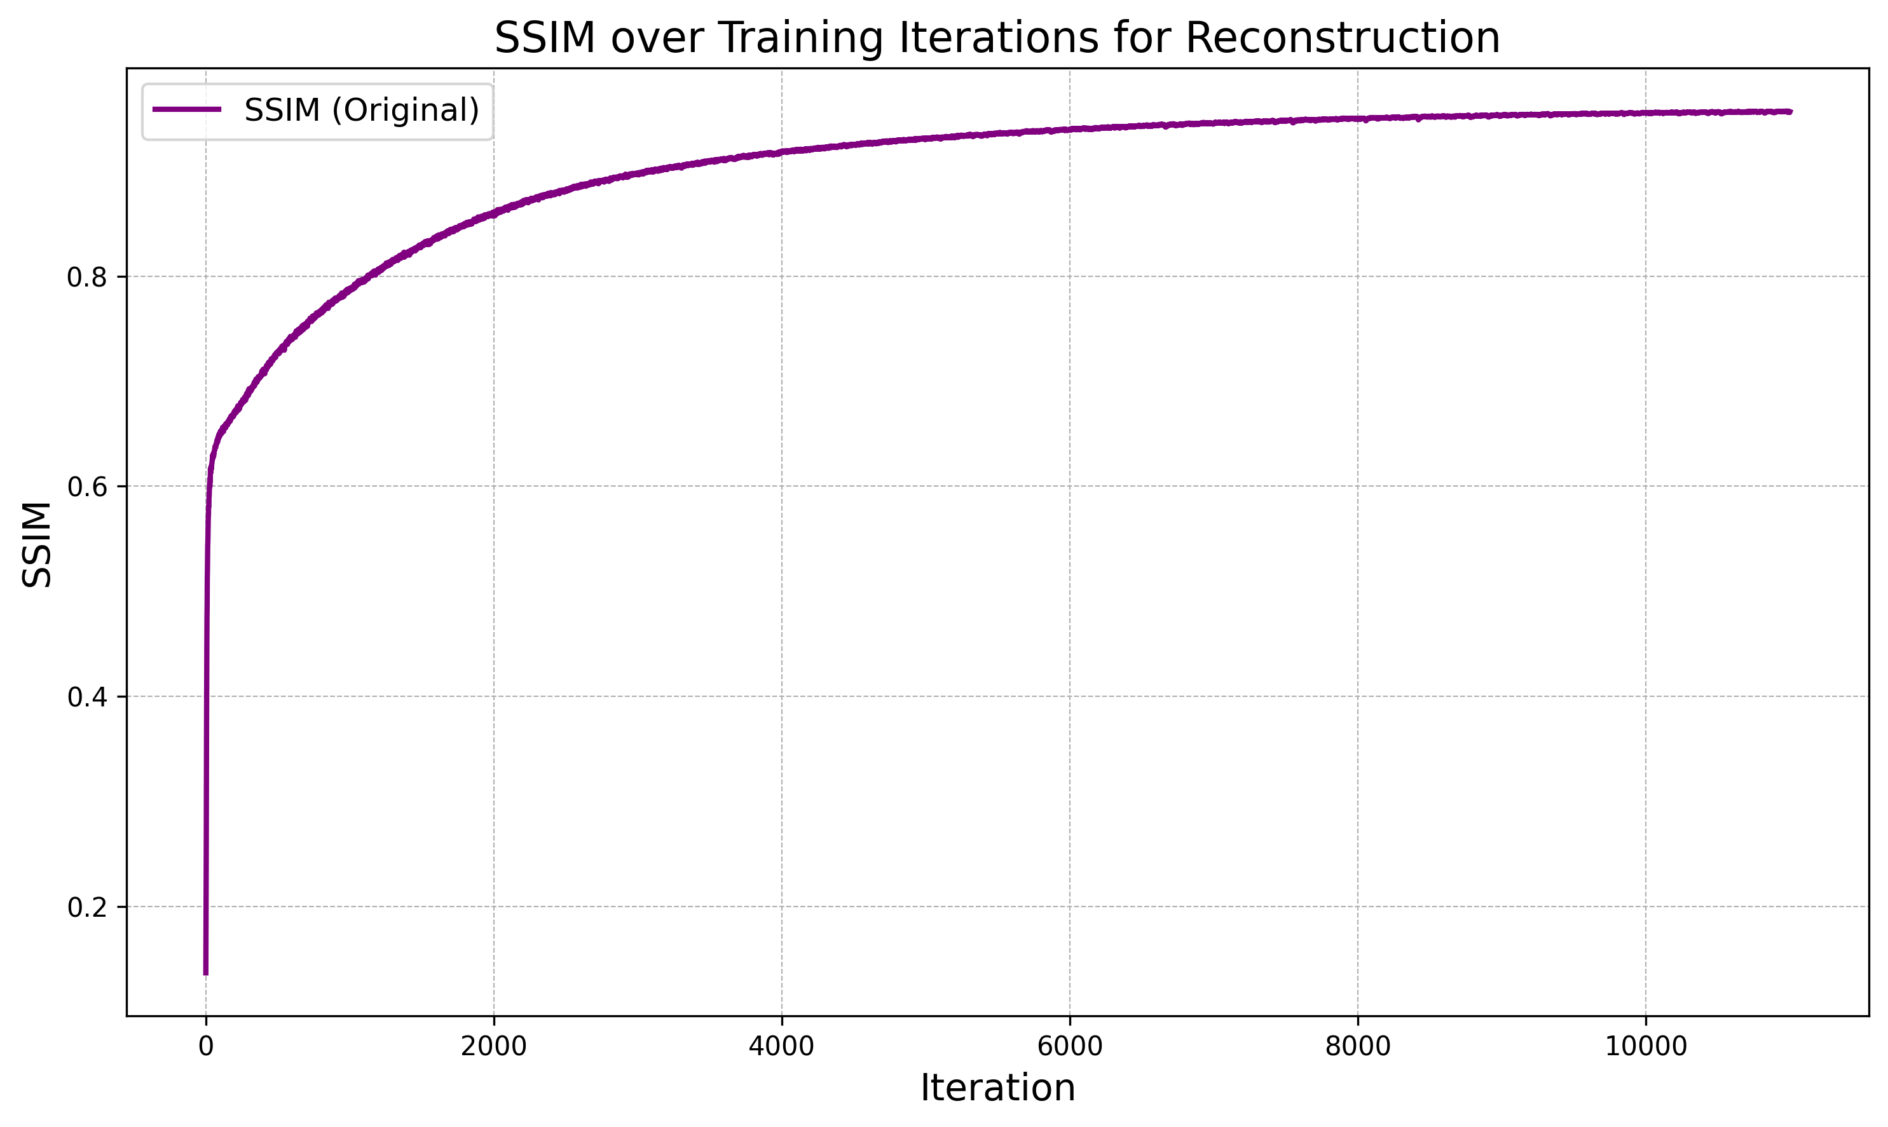
Quantitative Result – Image Reconstruction
SSIM score: [0.939079]

Slide 14
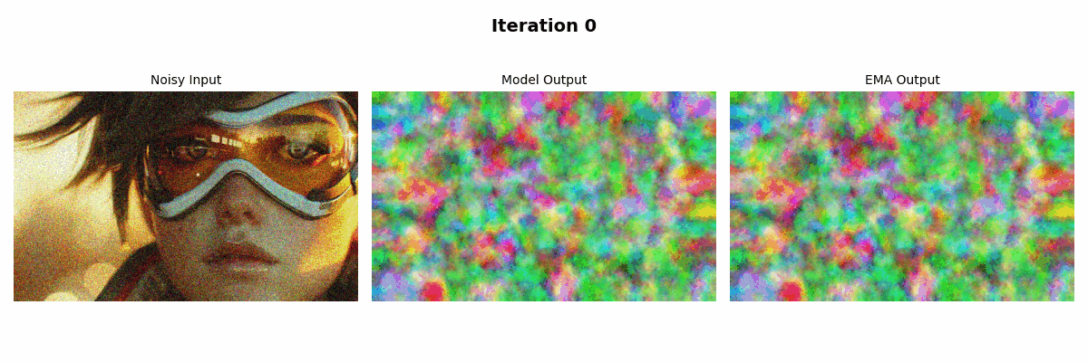
Model Demonstration - Denoising

Slide 15
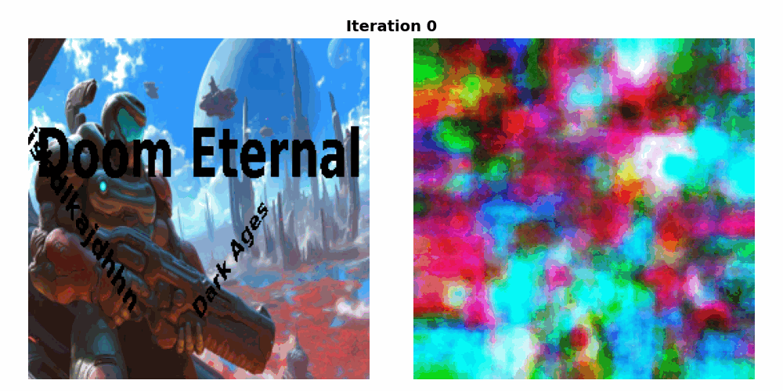
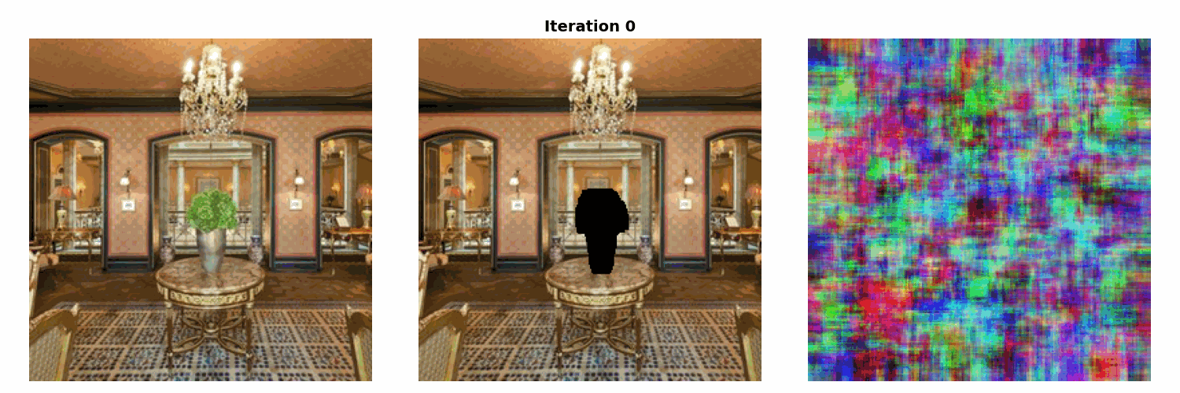
Model Demonstration - Inpainting
Text Inpainting
Corrupted Image
Output Image
Hole Filling
Original Image
Corrupted Image
Output Image

Slide 16
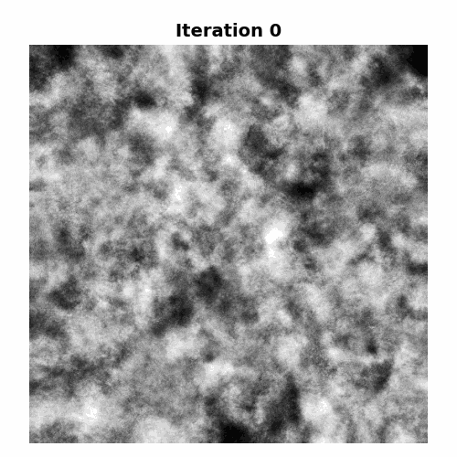

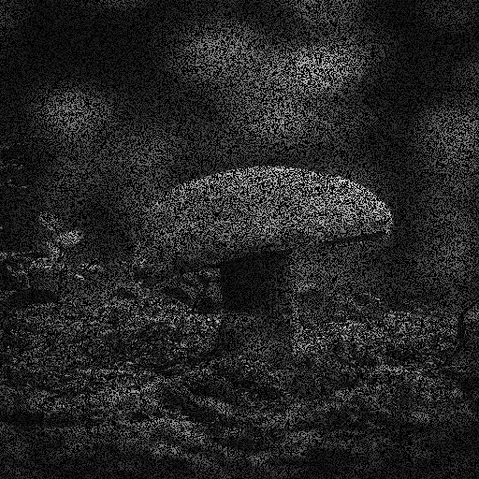
Model Demonstration – Reconstruction
Original Image
Corrupted Image
Output Image

Slide 17
Conclusion and Future Work
Strengths of Deep Image Prior:
Effectiveness for single-image tasks
No need for external training data
Limitations:
Computational intensity
Risk of overfitting
Potential improvements:
Adaptive early stopping mechanisms
Exploring alternative architectures

Slide 18

Thank You
Any questions ?

